Slide 1
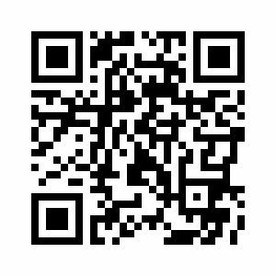
The C Group Creativity for change in Language Education
The C Group is an independent and informal grouping of EFL professionals. It aims collaboratively to share information, promote reflection and inquiry, and encourage action through more creative and open teaching practices.
More information and membership:
http://thecreativitygroup.weebly.com
creativity_group@yahoo.co.uk

